Slide 1
The Manage Patron Services Page Circulation Desk
Yoel Kortick July 2024

Slide 2
Agenda
Introduction
Accessing the Manage Patron Services page
Manage Patron Services Navigation Pane
Manage Patron Services page sections
The Pickup
Bulk Actions
Labels and Links
Table View and Record View
Patron Services Page Timeout

Slide 3
Introduction

Slide 4
Introduction
The Manage Patron Services User Interface has been completely redesigned in order to leverage new layout capabilities and support a more streamlined workflow at the circulation desk.
The redesign has been done with a number of concepts in mind:
  Right pane with expanded information, allowing to easily access additional loan information.
  Labels highlighting important information about the listed loans, such as loans being overdue, lost or highlighting fees associated with a loan
  Quicker and easier access to user information for view and update
  Separation of system notes and user notes, allowing better highlighting of patron related information

Slide 5
Introduction
The new Manage Patron Services Page Circulation Desk will be released
  In May 2024 as a “sneak preview” for the UX focus group
  In August 2024 for “early access” (opt in)
  In November 2024 for GA (General Availability)
For more roadmap-related information regarding the new The New Manage Patron Services Page Circulation Desk see
  Circulation Desk Redesign.
  The Fulfillment and Resource Sharing section of the Alma Roadmap Highlights: 2024 - 2025

Slide 6
Introduction
Note that in this presentation we are focusing on the loans of the Patron Services Page.
Similar and additional functionality exists also for the “Returns”, “Requests”, and “Fines and Fees”.

Slide 7
Accessing the Manage Patron Services page

Slide 8
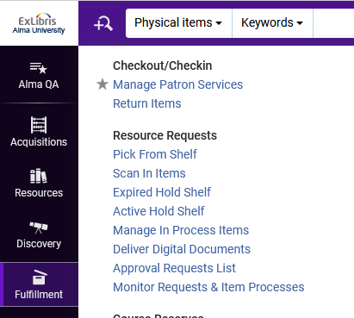
Accessing the Manage Patron Services page
Access to the new Manage Patron Services Page Circulation Desk is the same as it previously was.
Access to the Manage Patron Services Page can be done in two ways:
Option 1: Fulfillment > Checkout/Checkin > Manage Patron Services

Slide 9
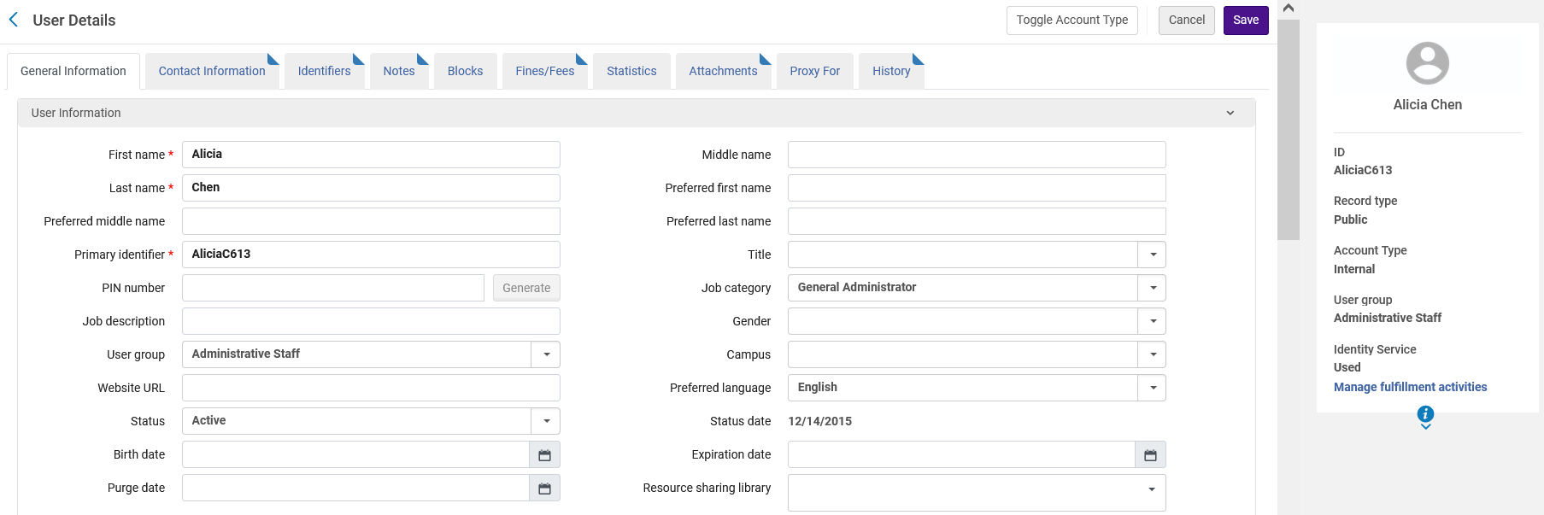
Accessing the Manage Patron Services page
Option 2: “Manage Fulfillment Activities” from the User Details screen

Slide 10
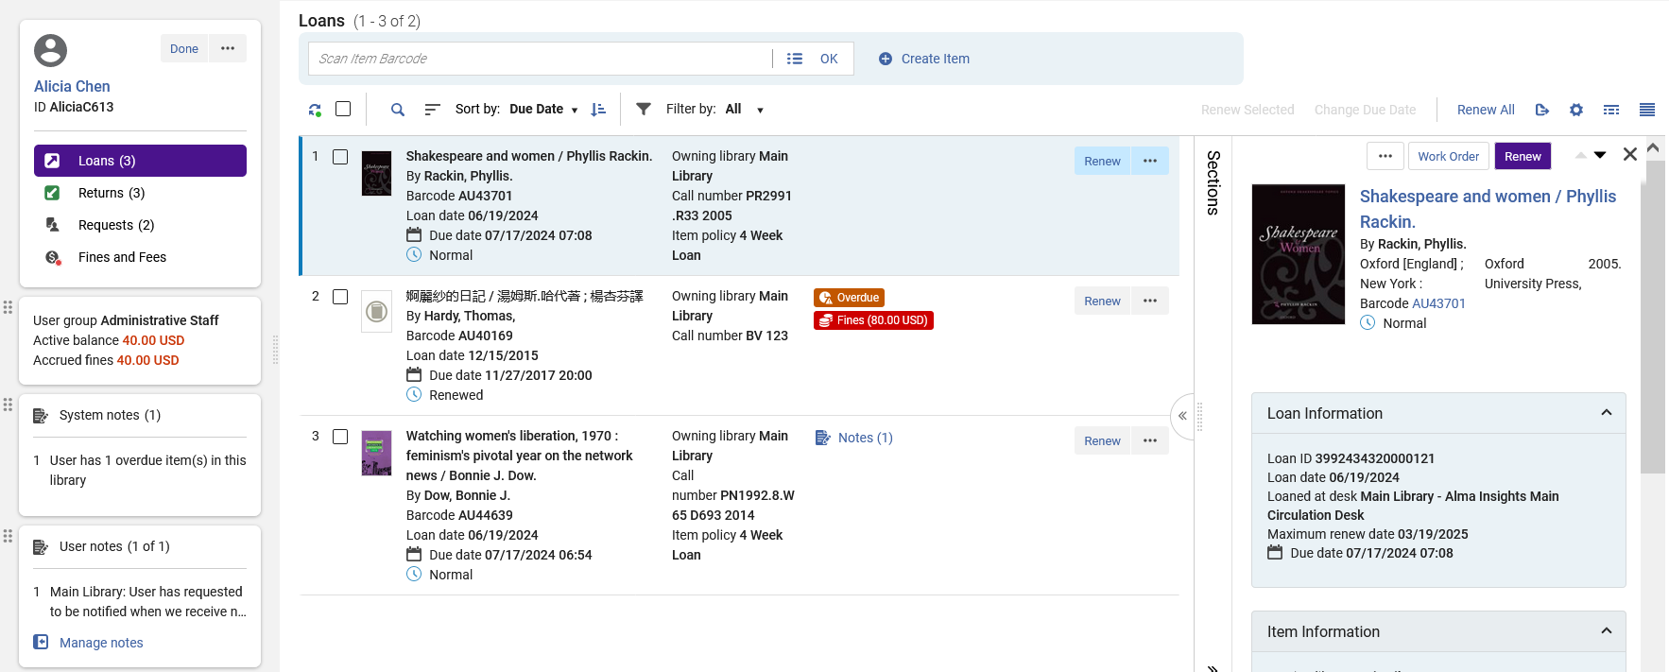
Accessing the Manage Patron Services page
Example of new Manage Patron Services
Example of new Manage Patron Services page

Slide 11
Manage Patron Services Navigation Pane

Slide 12
Manage Patron Services Navigation Pane
Click “Done” to end session and return to the patron identification screen

Slide 13
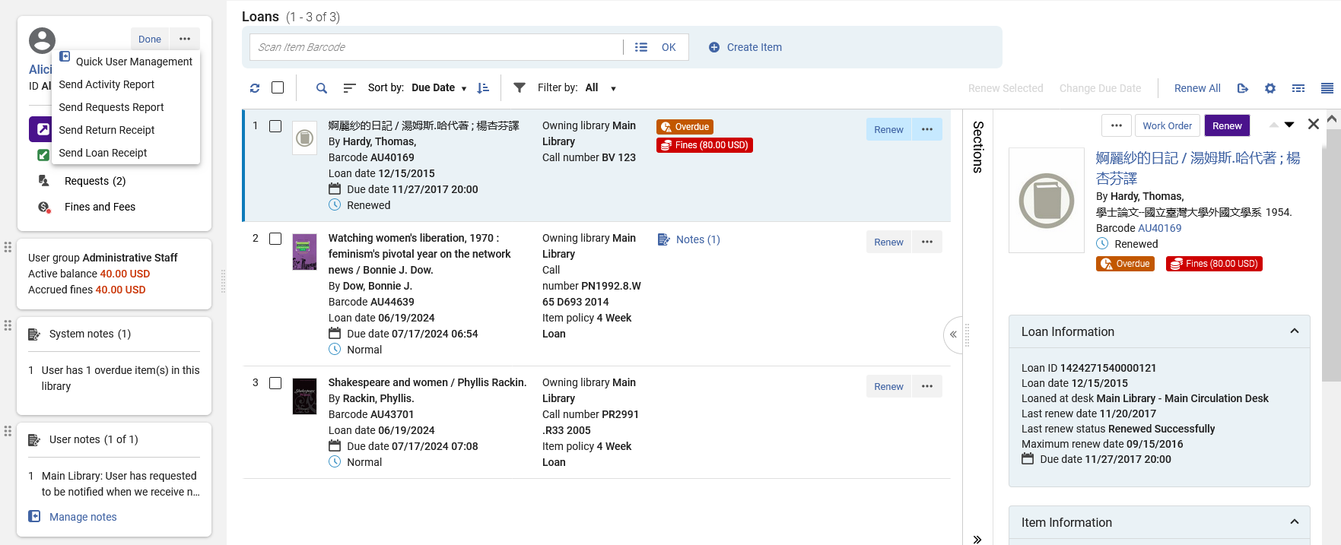
Manage Patron Services Navigation Pane
Click “More Actions” to
Access “Quick User Management”
Send Activity Report
Send Requests Report
Send Return Receipt
Send Loan Receipt

Slide 14
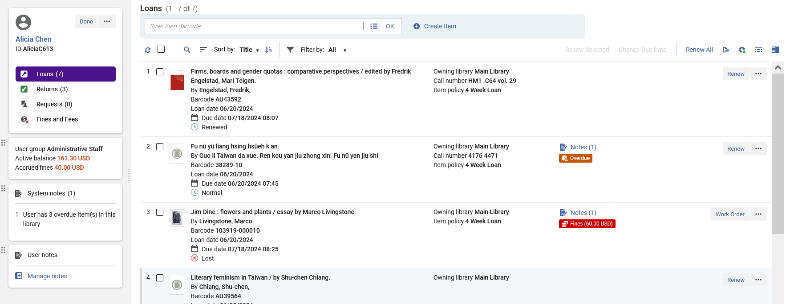
Manage Patron Services Navigation Pane
Click the link of the Patron’s name to open the “User Details” screen in a sliding panel where the patron can be viewed and updated

Slide 15
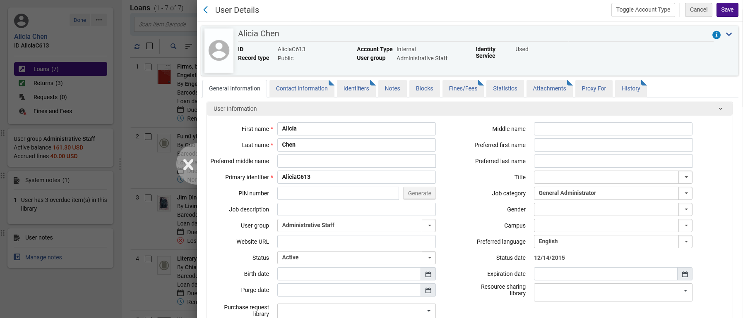
Manage Patron Services Navigation Pane
We have clicked the link of the Patron’s name to open the “User Details” screen in a sliding panel where the patron can be viewed and updated

Slide 16
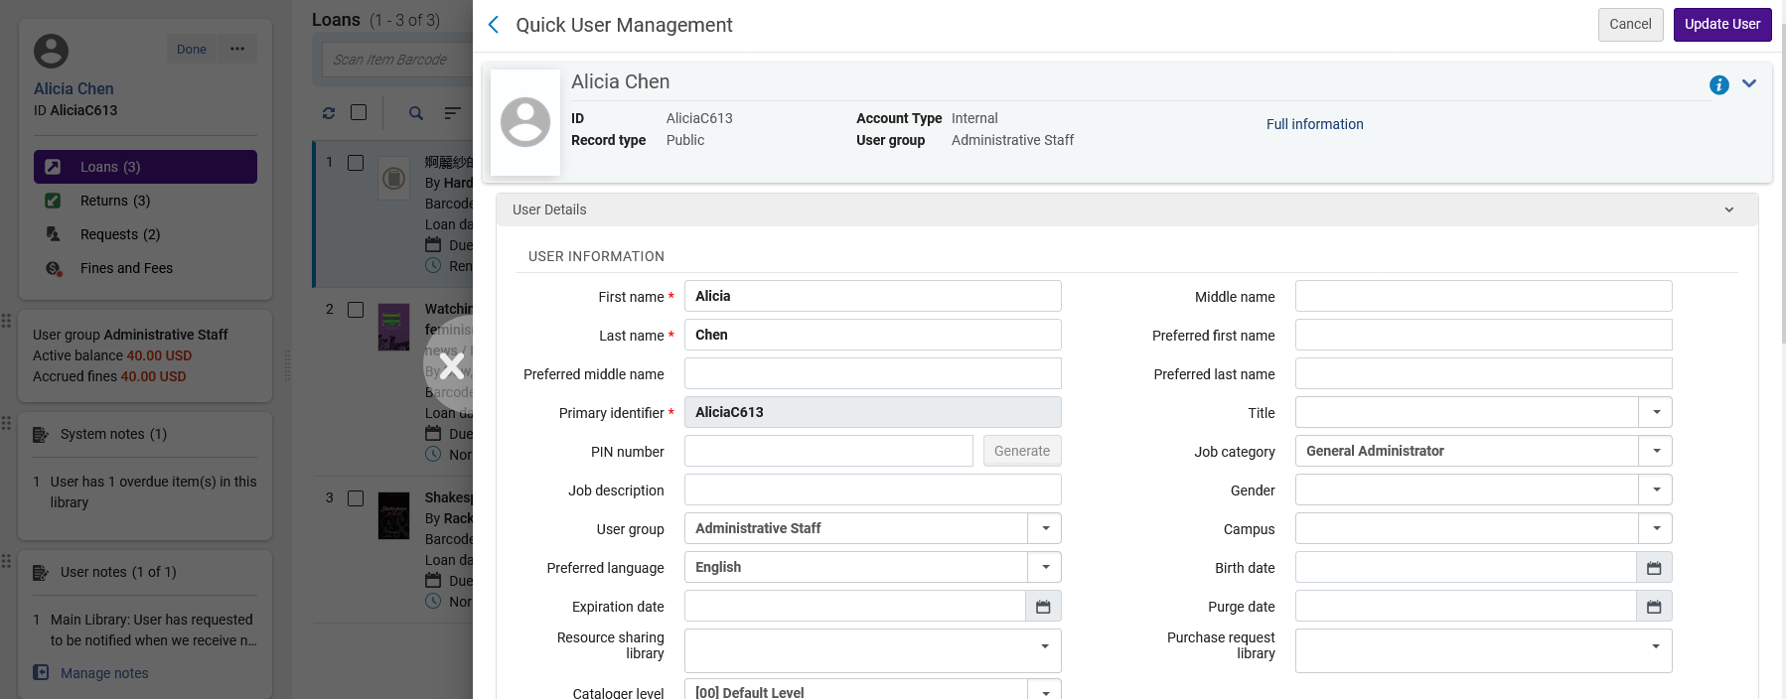
Manage Patron Services Navigation Pane
Link to full User Details page
“More Actions > Quick User Management” opens a sliding panel with the “Quick User management” screen, allowing the staff user to edit (and view) the user details without “losing context” (leaving the Manage Patron Services page).

Slide 17
Manage Patron Services Navigation Pane
Toggle between Loans, Returns, Requests, and Fines and Fees.

Slide 18
Manage Patron Services Navigation Pane
View information pertaining to
Patron User Group
Fines and Fees
System generated notes
User generated notes
Can also access and manage notes
We will now click “Manage notes”

Slide 19
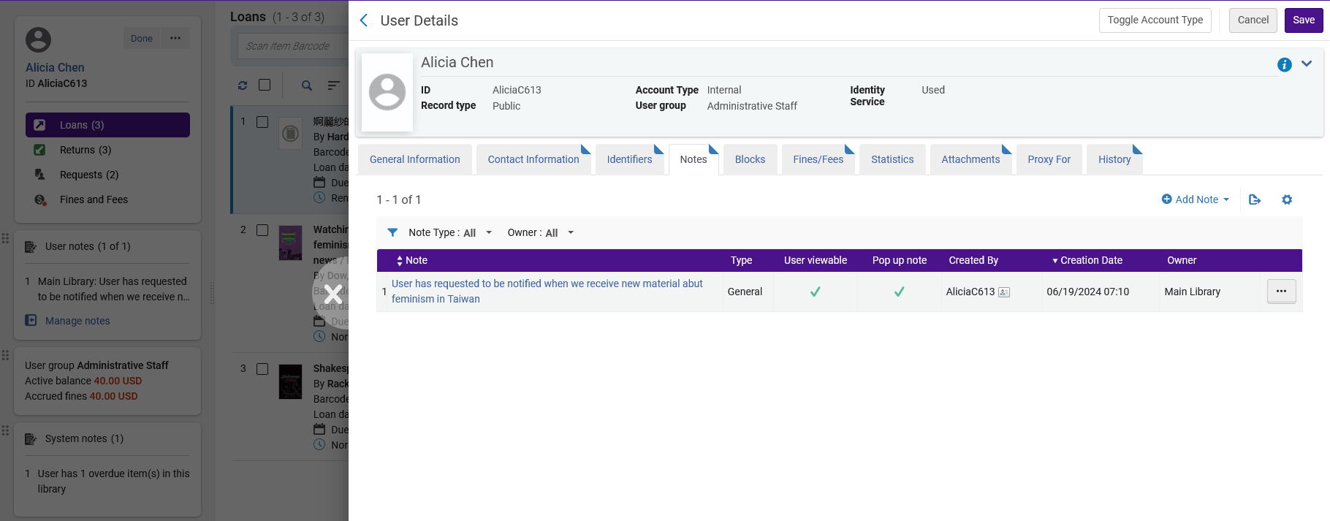
Manage Patron Services Navigation Pane
“Manage Notes” opens a sliding panel with the “User Details” screen open to the “Notes” tab, allowing the staff user to edit (and view) the user notes without “losing context” (leaving the Manage Patron Services page).

Slide 20
Manage Patron Services Navigation Pane
The appearance of the fields here can be controlled (fields can be added and removed) via “Configuration > Fulfillment > Patron Configurations > Patron Services User Card Fields”

Slide 21
Manage Patron Services Navigation Pane
These entities can be reordered using the drag and drop icons.
We will now drag “User notes” to be first instead of third

Slide 22
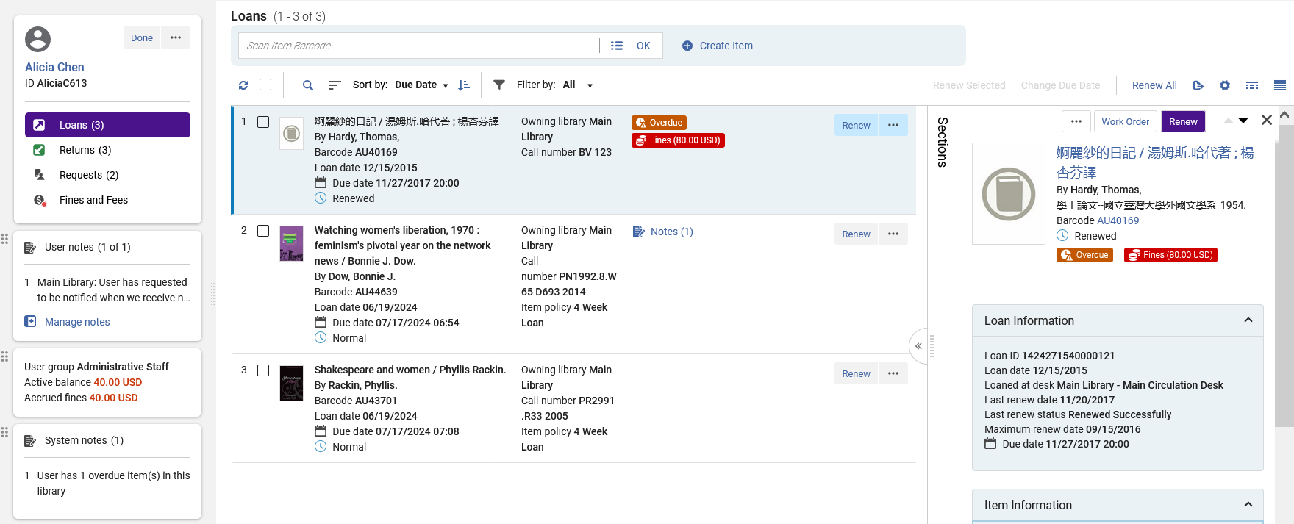
Manage Patron Services Navigation Pane
Now “User notes” is first instead of third

Slide 23
Manage Patron Services page List and Split Screen View

Slide 24
Manage Patron Services page List and Split Screen View
The staff user can switch between Split Screen View and List View.
This can be done via the icon on the top right, or by double clicking an entity from the List View.
List View shows more results per page than Split Screen View
The advantage of Split Screen View is that the staff user can see more details of the record without “losing context”. This means that the staff user can see in depth details of the record in the right pane without needing to leave the list and then come back.
It is also possible to view a “Table View”, as we will see later.

Slide 25
Manage Patron Services page List and Split Screen View
Can switch between List View and Split View (now we are in Split View)

Slide 26
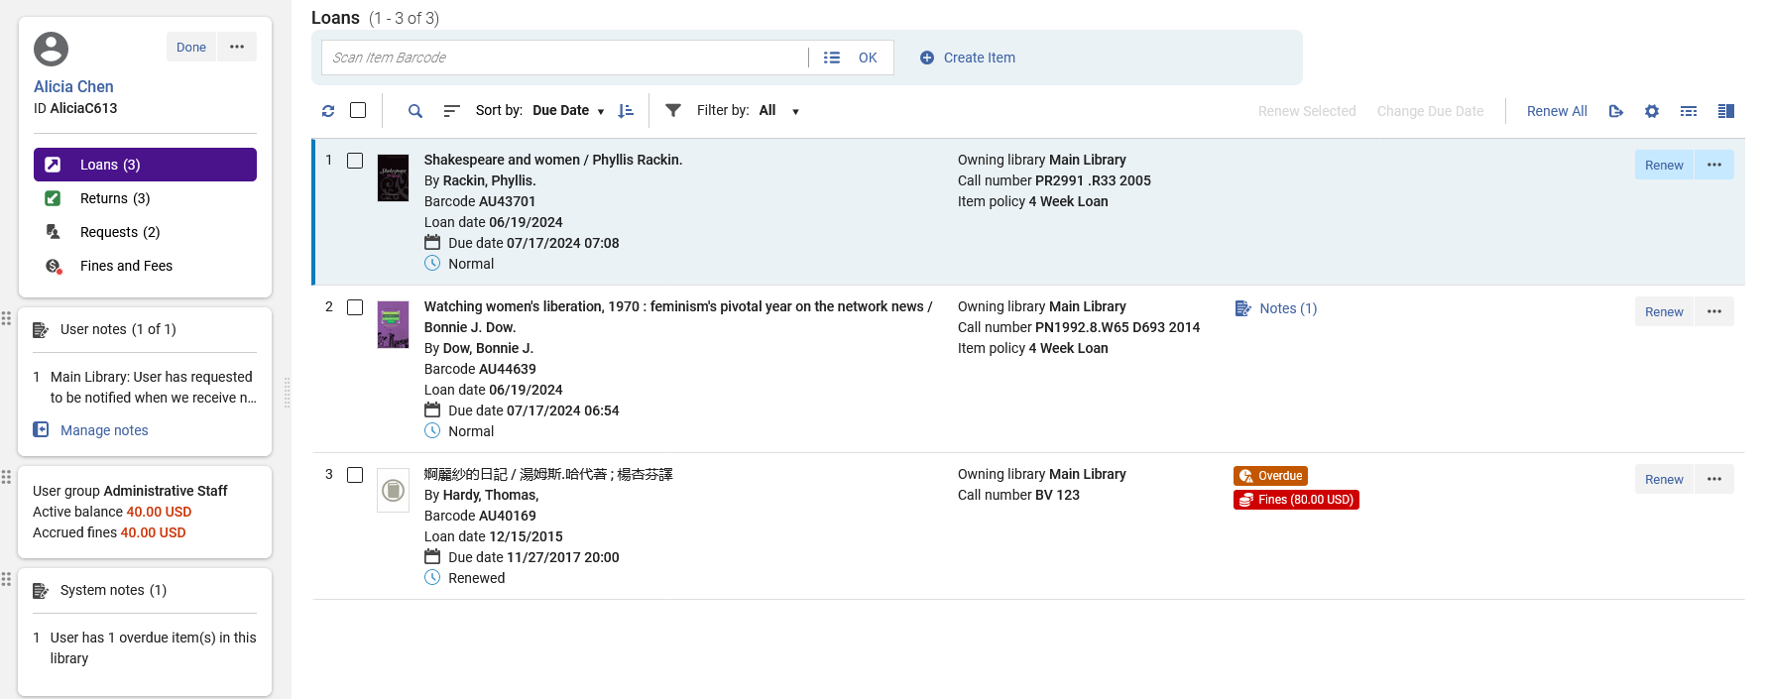
Manage Patron Services page List and Split Screen View
Now we are in List View

Slide 27
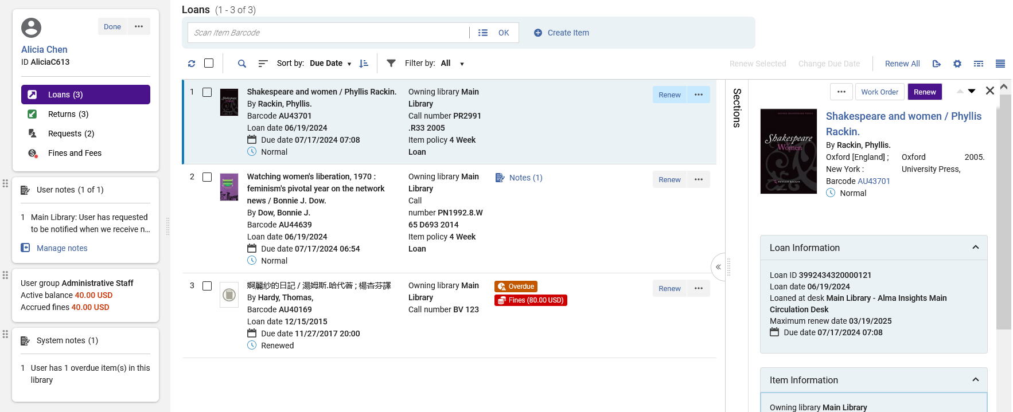
Manage Patron Services page List and Split Screen View
Now we are in Split View and can view entity details in the right pane
We will now open the “Sections”

Slide 28
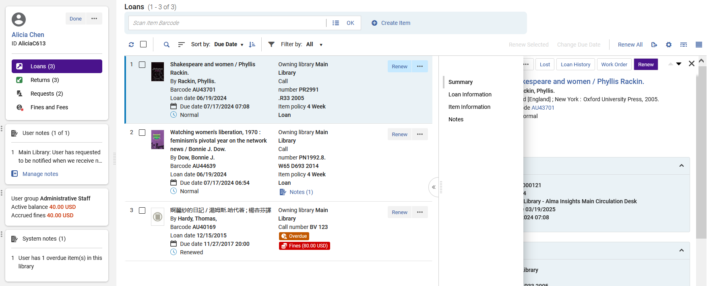
Manage Patron Services page List and Split Screen View
Clicking a section allows the staff user to navigate the entity details instead of using the scroll bar

Slide 29
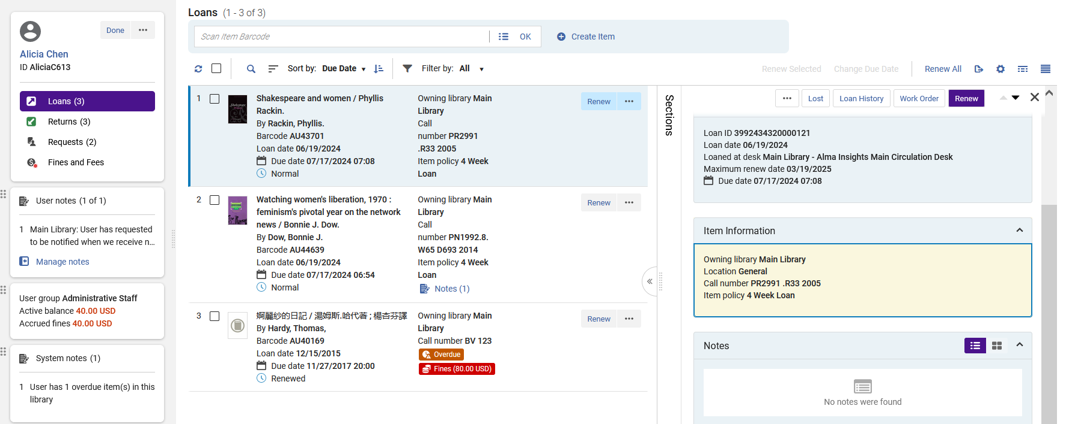
Manage Patron Services page List and Split Screen View
Here we have navigated to section “Item Information” and it is highlighted in yellow

Slide 30
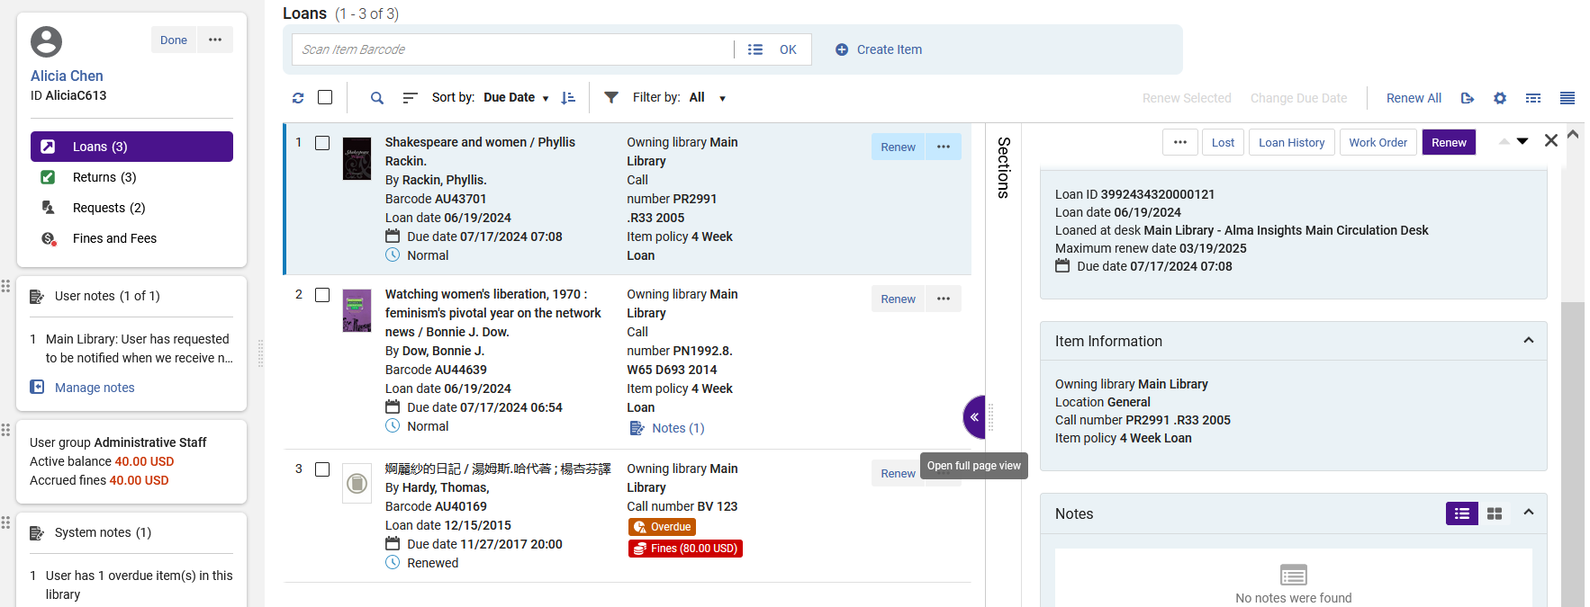
Manage Patron Services page List and Split Screen View
From the Split Screen View the staff user can switch to “Full View” by clicking the “Open Full Page View” icon

Slide 31
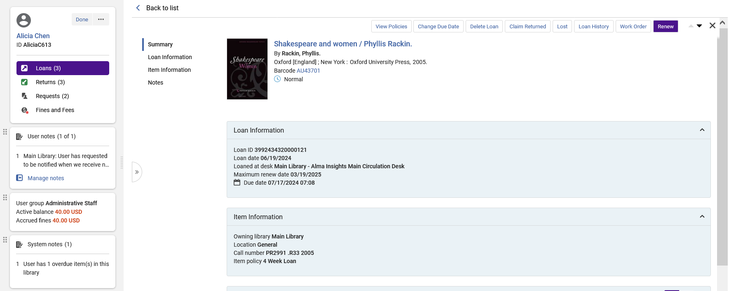
Manage Patron Services page List and Split Screen View
Now we are in Full Page View and can therefore more easily view the entity details
Also, in the Full Page View the user can quickly and easily navigate to the sections instead of using the scrollbar.

Slide 32

Manage Patron Services page List and Split Screen View
The staff user can also get to Full Page View by double clicking an entity. We will double click the second entity “Watching women’s liberation, 1970”.
Note that in some cases, whether or not a user will arrive to Split Screen view or Full Page view depends on the screen resolution of the user.

Slide 33
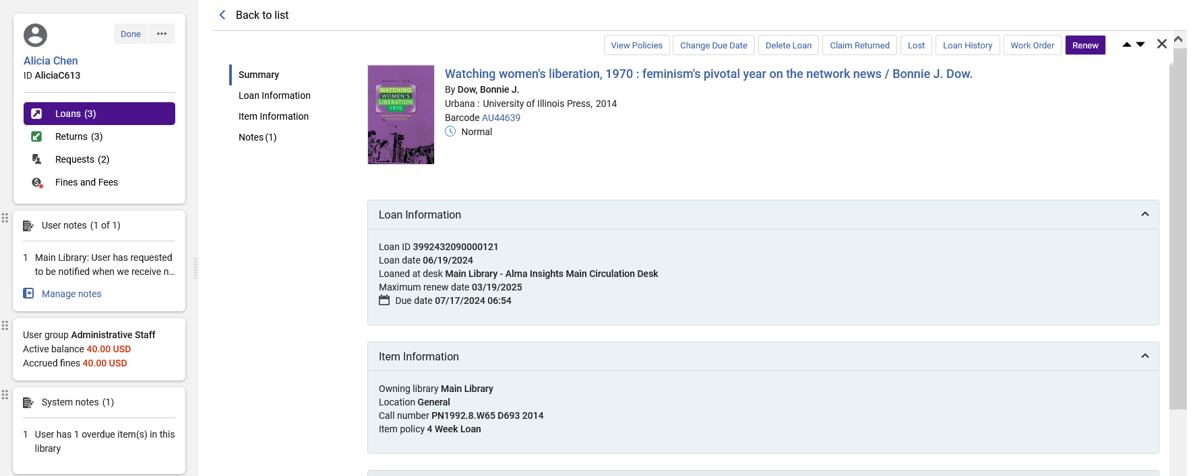
Manage Patron Services page List and Split Screen View
Now we are in Full Page View for entity “Watching women’s liberation, 1970”.

Slide 34
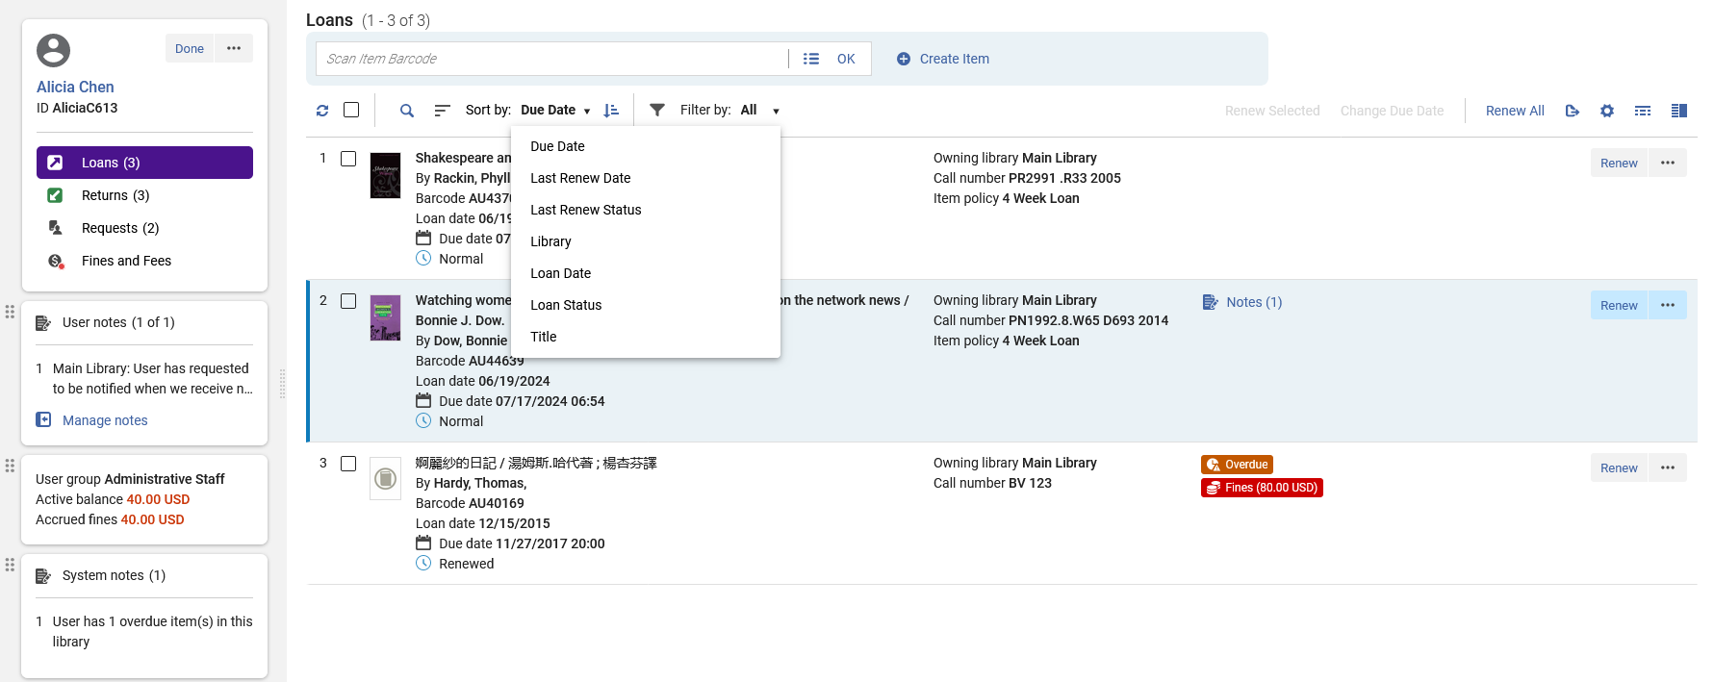
Manage Patron Services page List and Split Screen View
The List View and Split Screen View can be sorted by a myriad of fields, in either ascending or descending order.

Slide 35
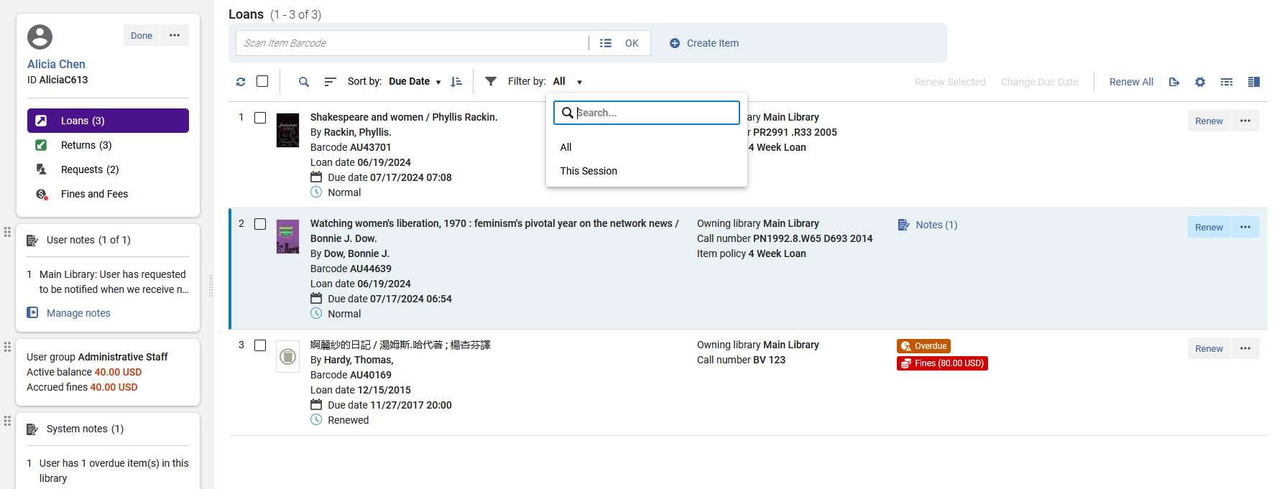
Manage Patron Services page List and Split Screen View
The list can also be filtered by “All” entities or only entities handled in “This Session”.

Slide 36
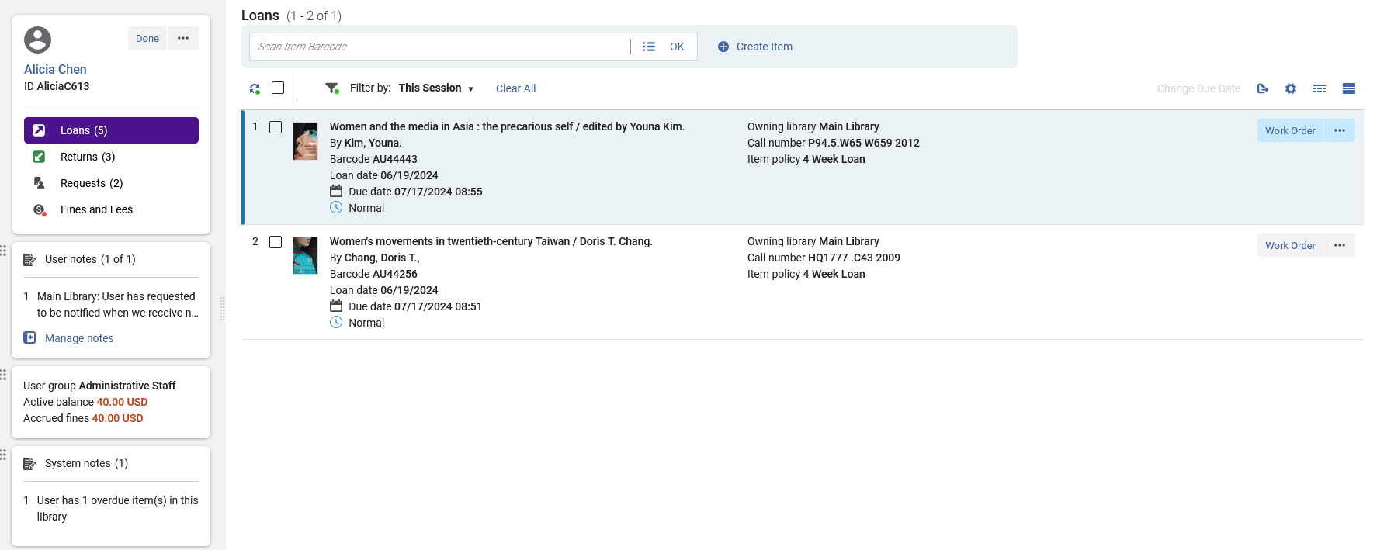
Manage Patron Services page List and Split Screen View
Note that “This Session” does not include the “Sort By” option
Here for example, we have chosen to filter by “This Session”.
We therefore see only the two loans handled in this session even though there are a total of five loans.

Slide 37
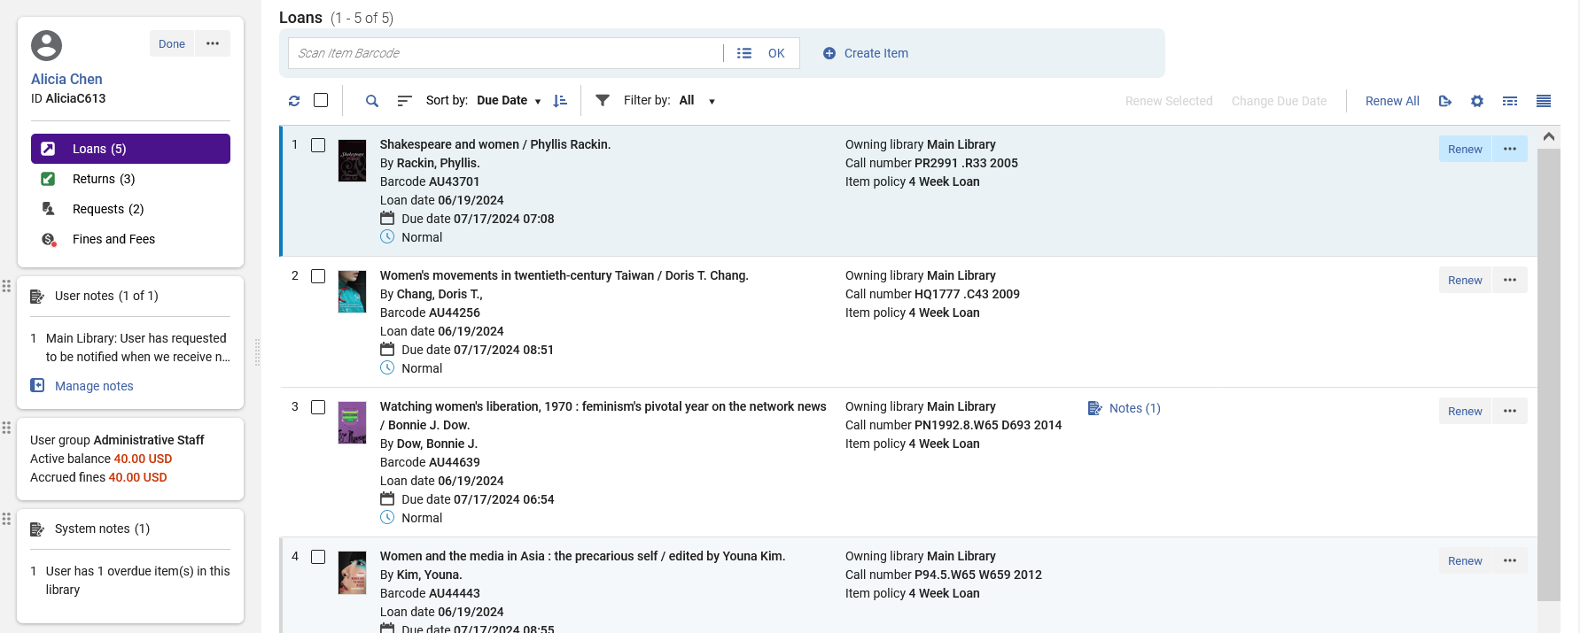
Manage Patron Services page List and Split Screen View
Note that “All” does include the “Sort By” option
Here for example, we have chosen to filter by “All”.
We therefore see all five loans including the two loans handled in the current session.

Slide 38
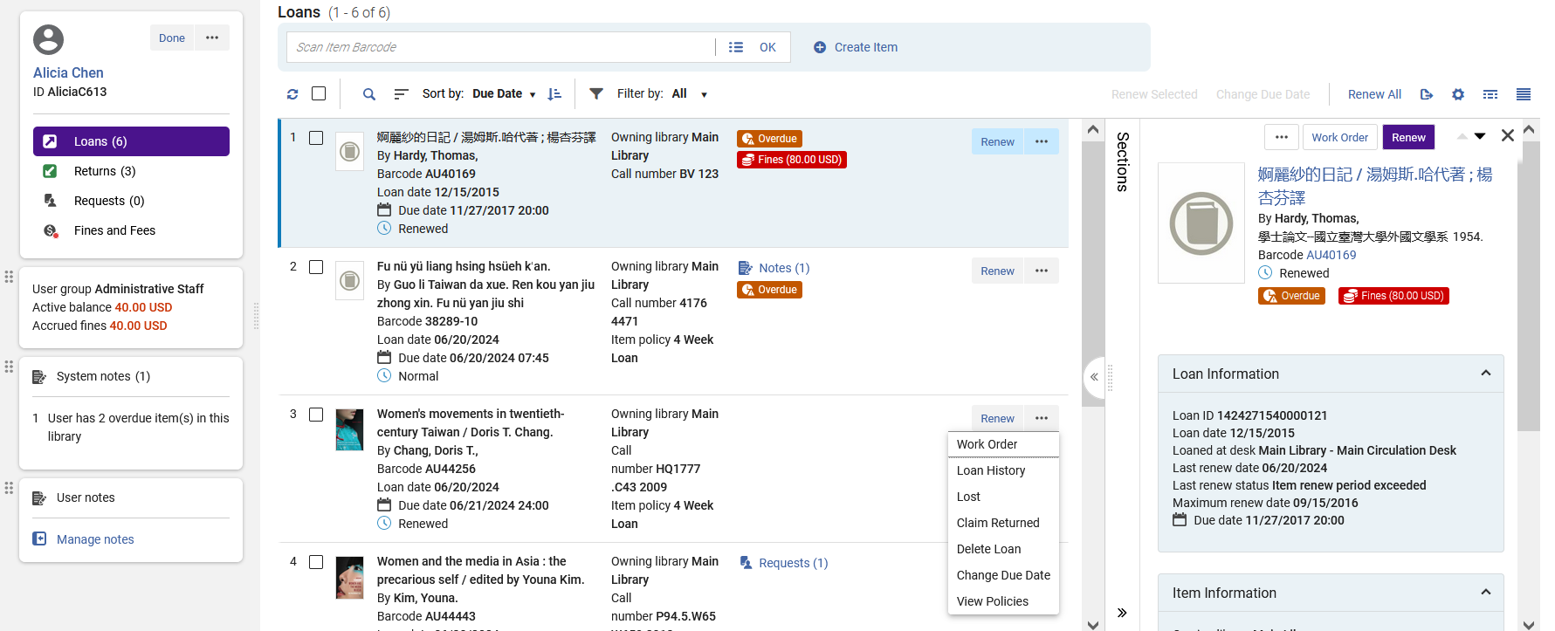
Manage Patron Services page List and Split Screen View
From both the list view, the right pane, and the full view a variety of actions can be performed on each specific loan (we will discuss Bulk Actions later)

Slide 39
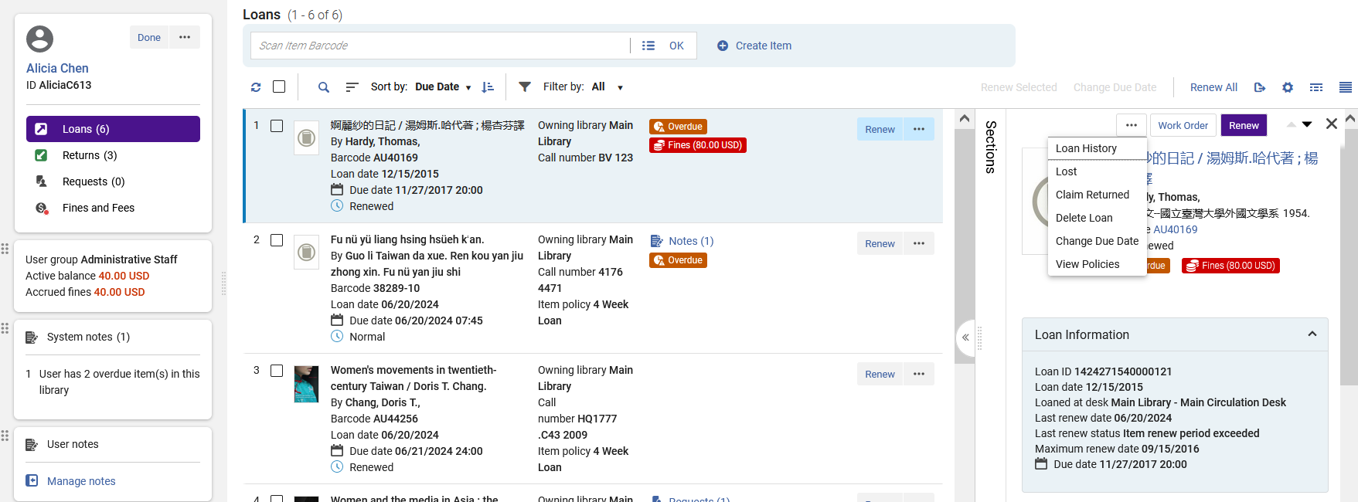
Manage Patron Services page List and Split Screen View
The same functions can also be accessed here in the right pane

Slide 40
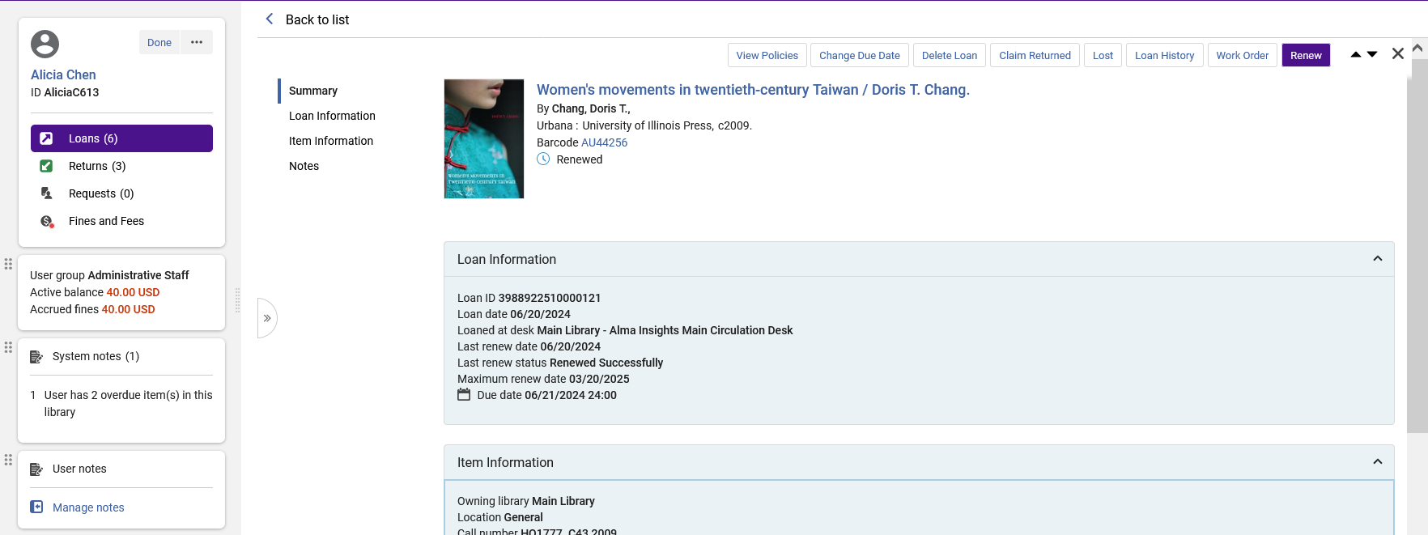
Manage Patron Services page List and Split Screen View
The same functions can also be accessed here in the full view

Slide 41
Manage Patron Services page sections

Slide 42
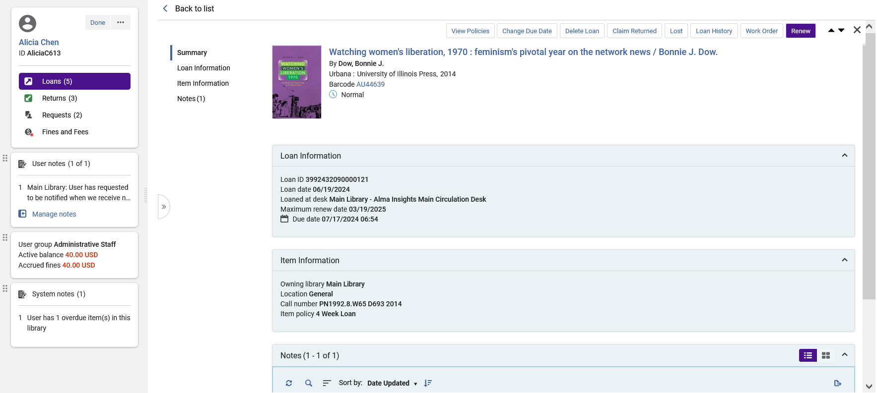
Manage Patron Services page – Sections
As already pointed out, from both Full Page View and Split View, the staff user can navigate through the parts of the entity via the “Sections”.
This is a more efficient method of moving through the record than using the scrollbar on the right.

Slide 43
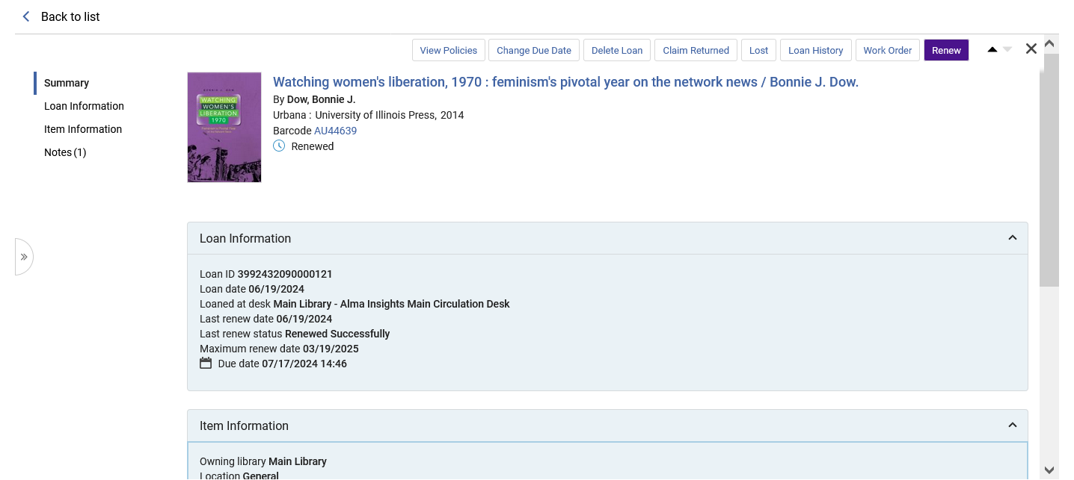
Manage Patron Services page – Summary Section
The Summary section includes:
Basic bibliographic information
A link to the item via the barcode (more on that ion the next slide)
If the item has been renewed (or has been declared lost, or has a fine)

Slide 44
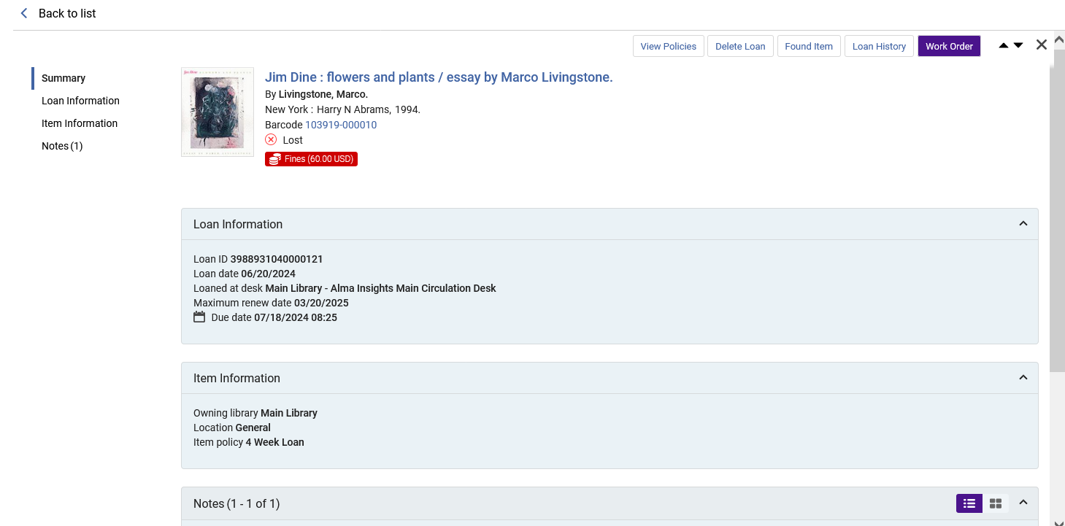
Manage Patron Services page – Summary Section
Here is the Summary Section for a loan which has been declared lost and has a fine.

Slide 45
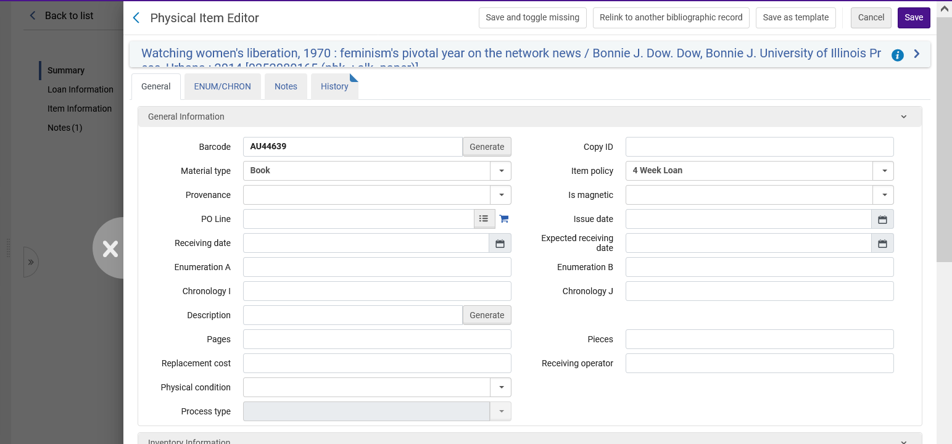
Manage Patron Services page – Summary Section
From the Summary Section, Clicking the link to the item via the barcode opens the physical item editor in a sliding panel to view and edit.
By opening in a sliding panel, the staff use does not lose his or place (context) of where he or she is working.
Clicking here closes the sliding panel, and the staff user returns to where he or she was working.

Slide 46
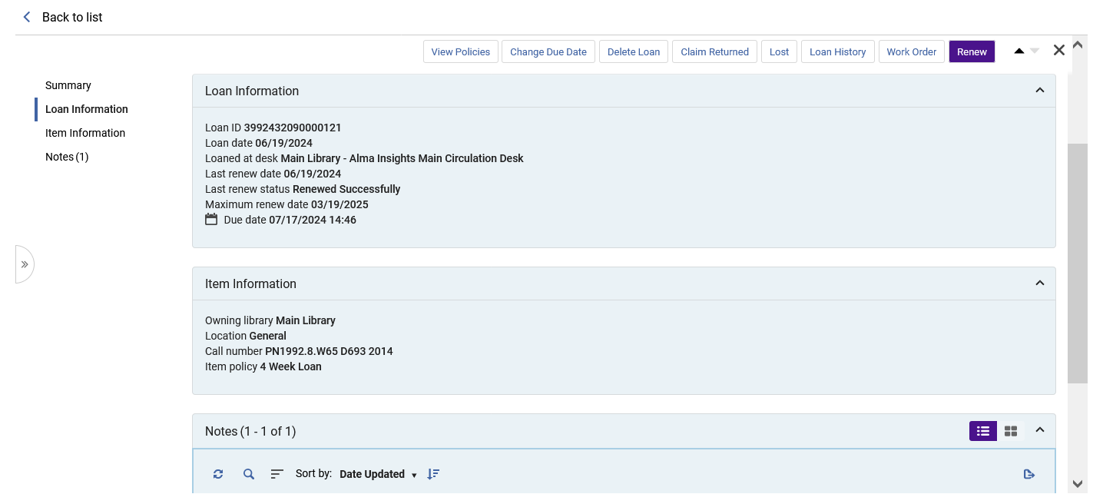
Manage Patron Services page – Loan Information Section
The Loan Information section includes:
Loan ID
Loan date
Loaned at desk
Last renew date
Last renew status
Maximum renew date
Due date 07/17/2024 14:46t

Slide 47
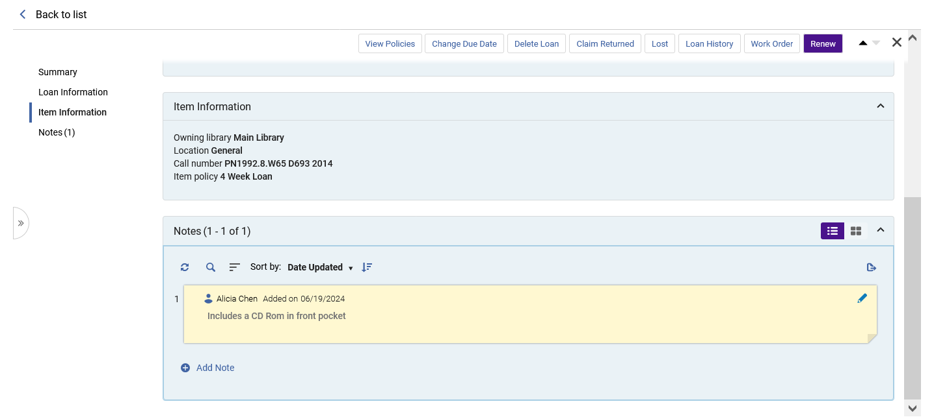
Manage Patron Services page – Item Information Section
The Item Information section includes:
Owning Library
Location
Call Number
Item Policy

Slide 48
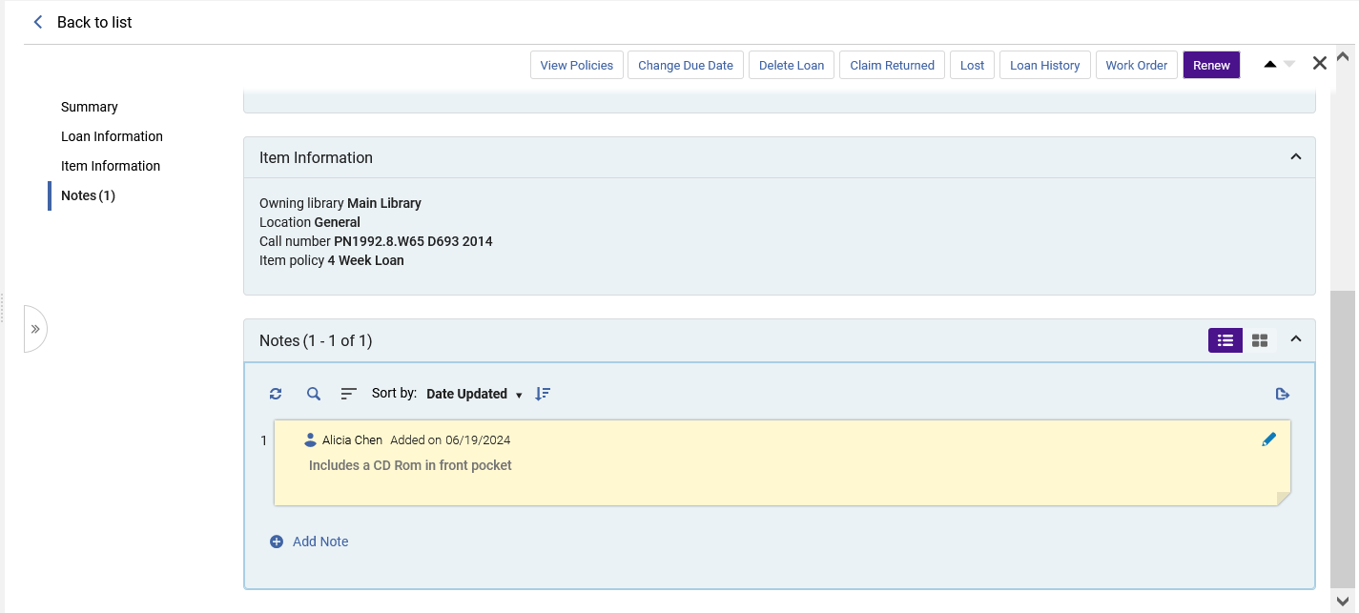
Manage Patron Services page – Notes Section
The Notes section includes:
A list of notes which can be sorted by the note text, the creation date or the update date.
These are the “Fulfillment notes” which appear in the “Functional Notes” section of the “Notes” tab of the Physical Item Editor), as well as system generated notes.
A link to the staff user who added the note (when it is not a “system note”)
A link to add an additional note
We will now click the link to the staff user who added the note

Slide 49
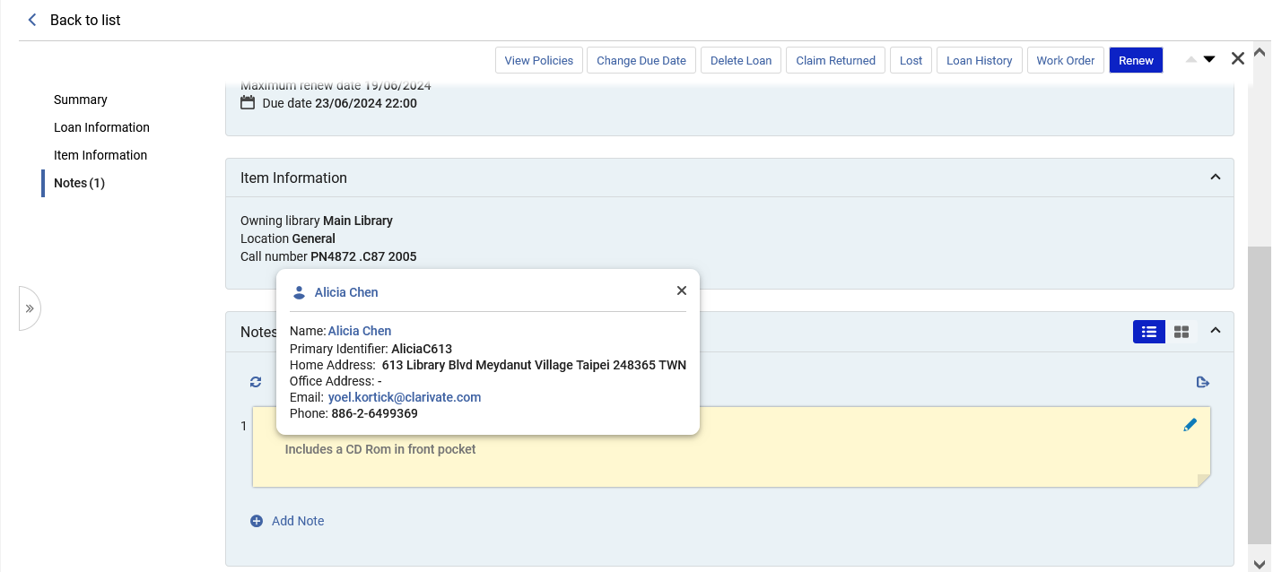
Manage Patron Services page – Notes Section
We see the staff user details.
Clicking the email will open the local email program to send an email.
Clicking the name of the staff user will open the staff user in the
We will again click the link to the staff user who added the note

Slide 50
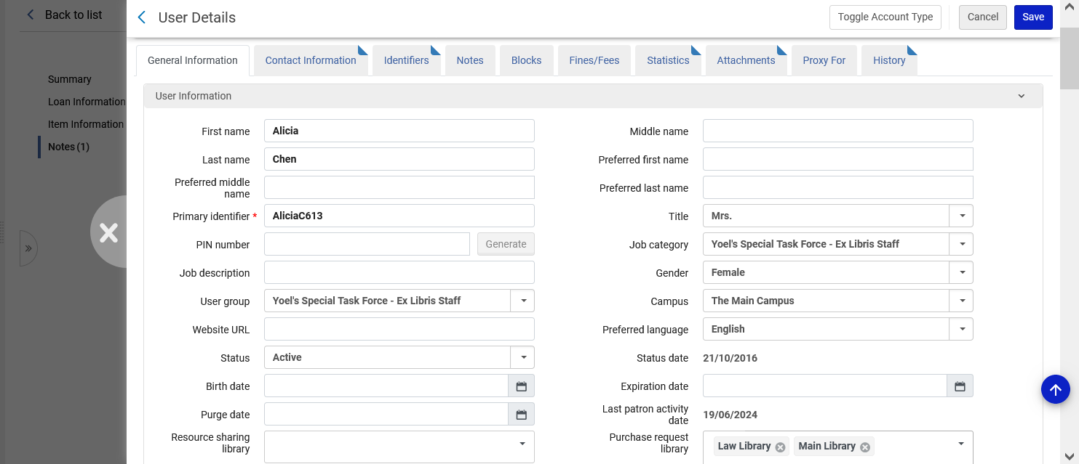
Manage Patron Services page – Notes Section
A sliding panels opens with the User Details screen for viewing and editing

Slide 51
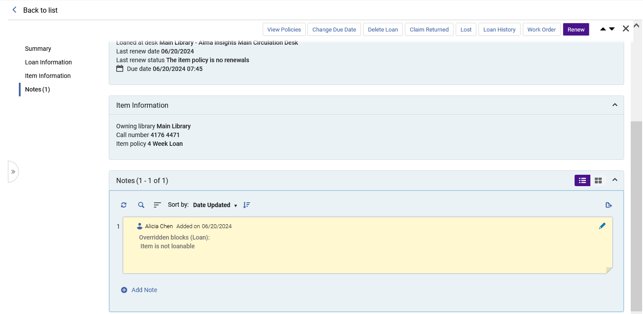
Manage Patron Services page – Notes Section
System Generated notes (and not only notes added manually) also appear in the Notes section.

Slide 52
The Pickup

Slide 53
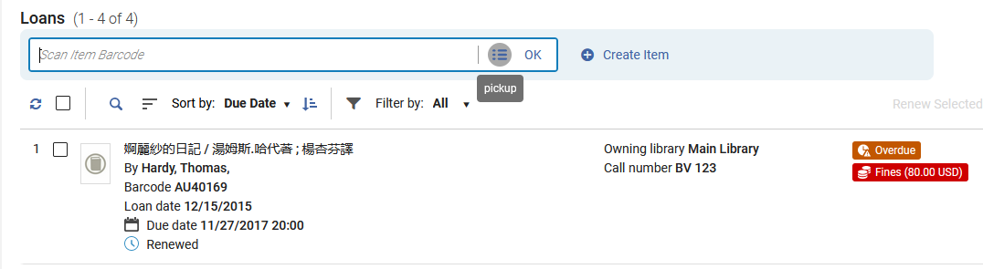
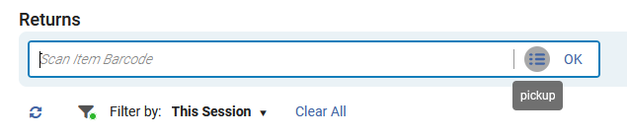
The Pickup
The Pickup is used to search for an item for which the barcode is not known. It exists for both Loans and Returns

Slide 54
The Pickup
For example, now we want to loan the item “Women and the media in Asia : the precarious self” and do not know the barcode (and cannot find the barcode on the item).
While loaning we will click the Pickup icon

Slide 55
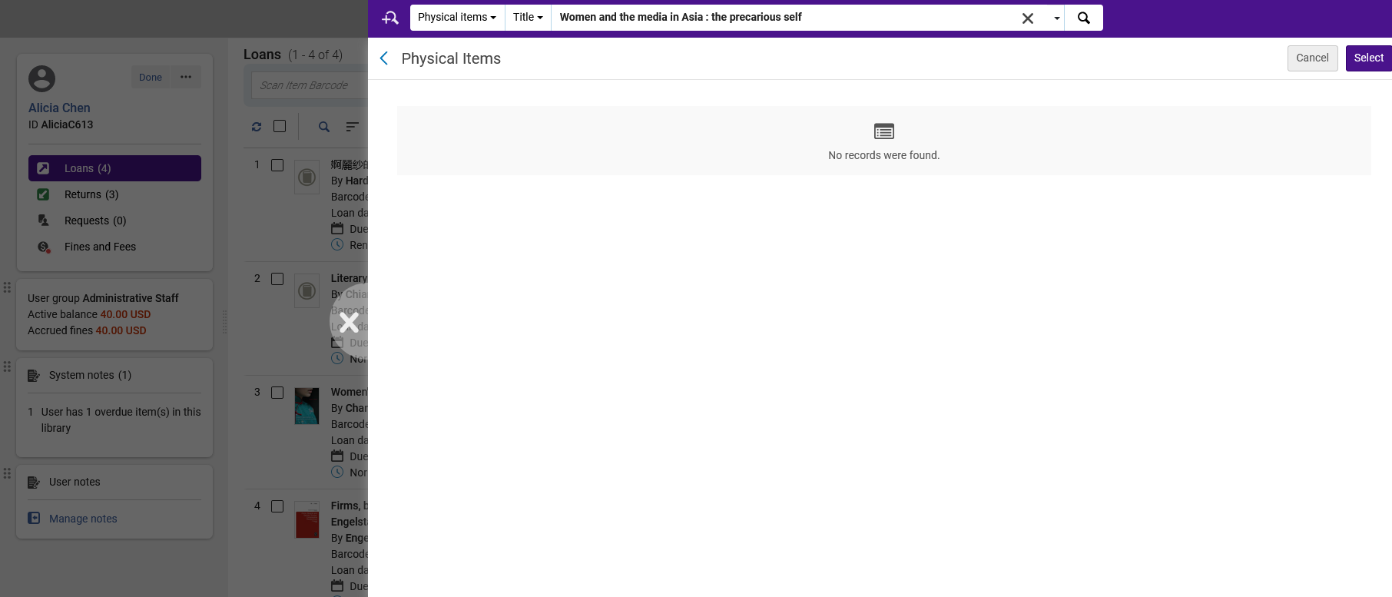
The Pickup
Search for the item.
A sliding panel opens for the physical items search and we can search for the item.

Slide 56
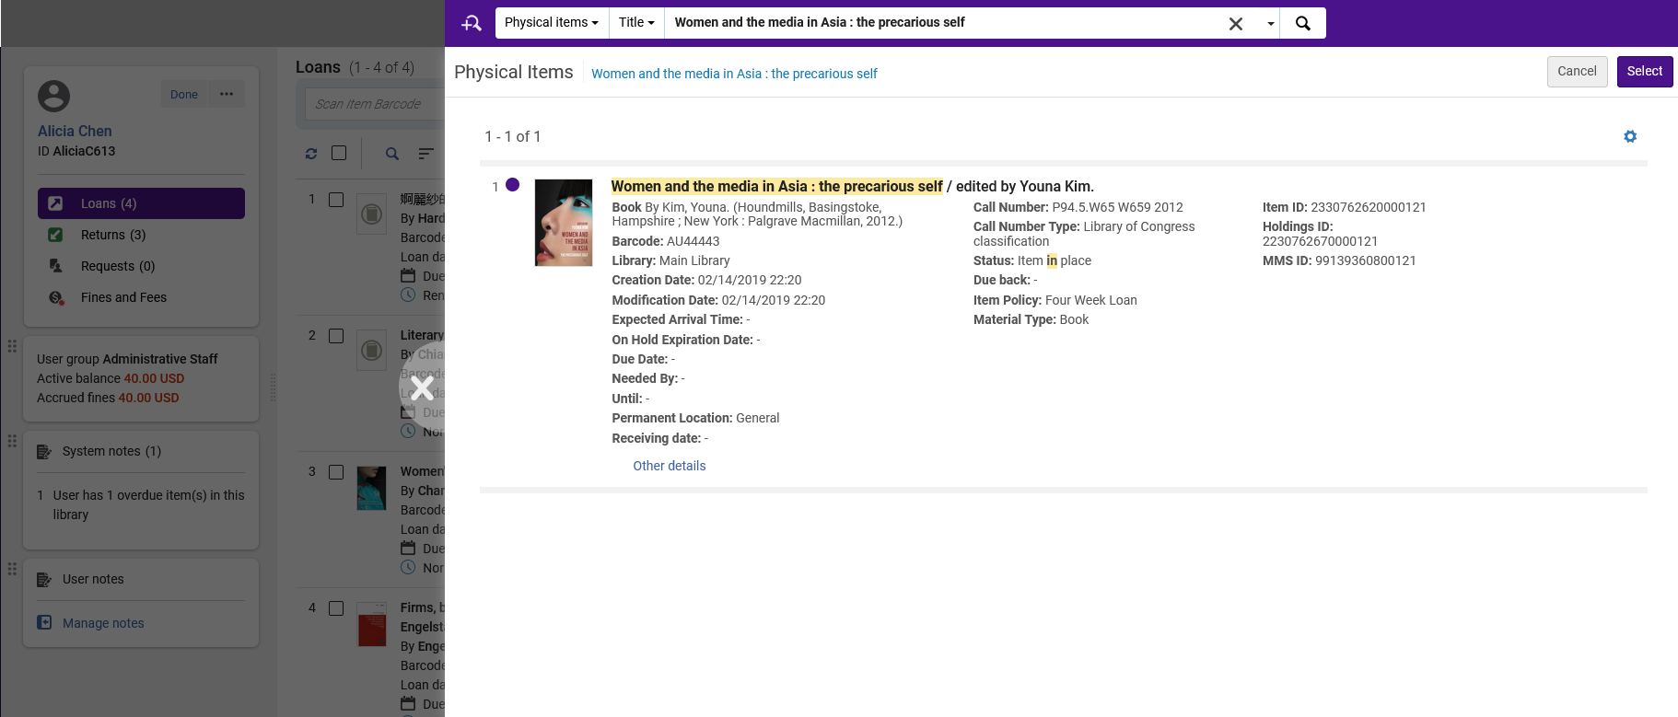
The Pickup
Select the item.

Slide 57
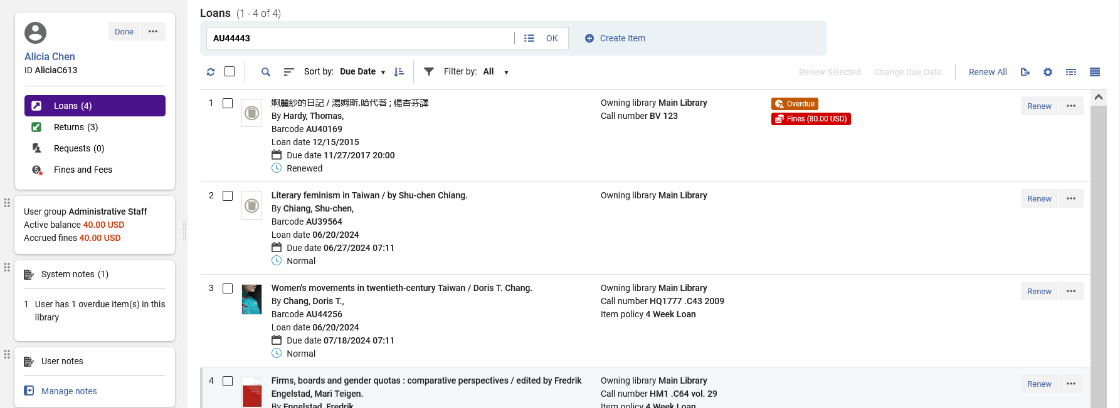
The Pickup
Now we can loan the item.

Slide 58
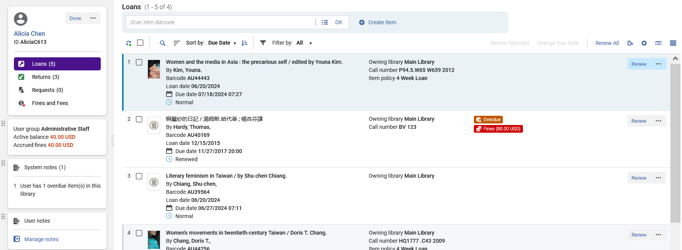
The Pickup
Item is loaned

Slide 59
Bulk Actions

Slide 60
Bulk Actions
It is also possible to perform Bulk Actions on the list of loans
Multiple loans can be chosen and then a bulk action can be applied to the loans.
The bulk actions include:
  Renew Selected
  Change Due Date
  Renew All

Slide 61
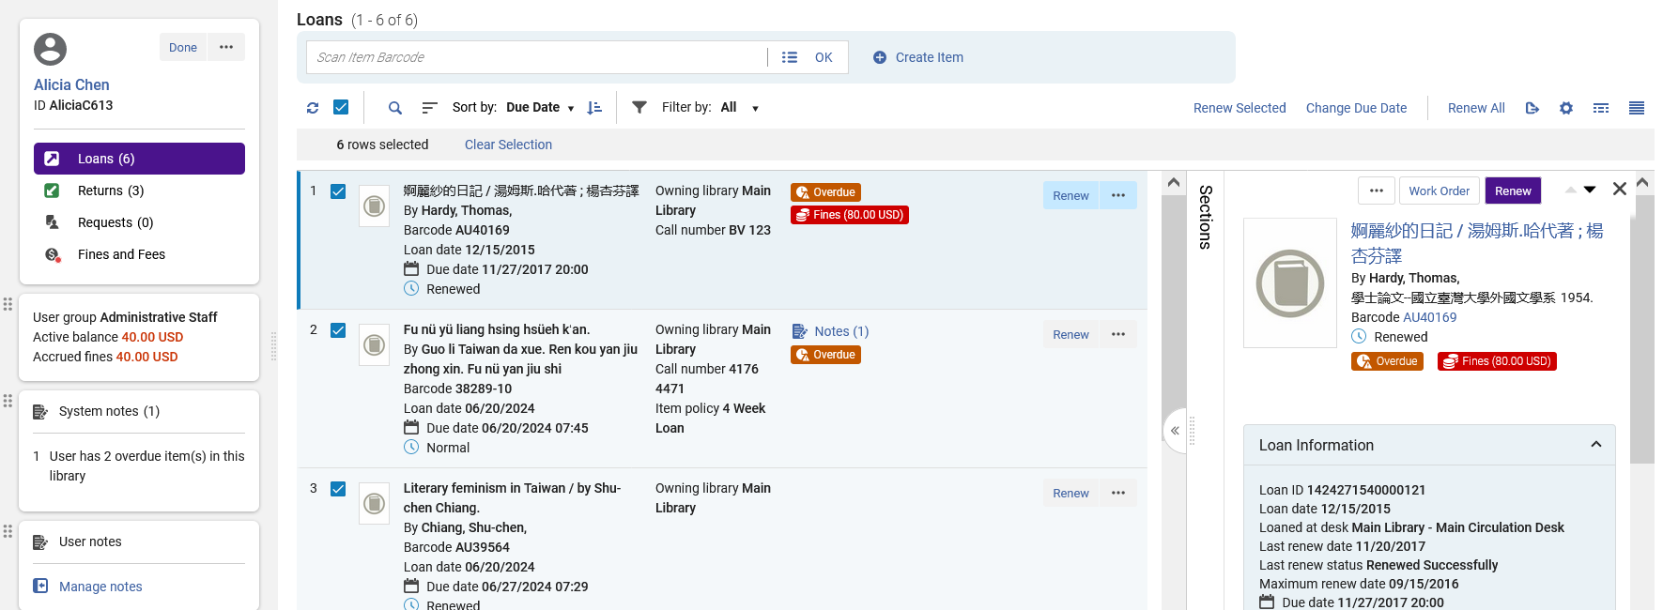
Bulk Actions
We will choose “Renew Selected

Slide 62
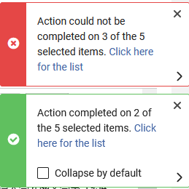
Bulk Actions
The staff user receives a notification regarding the activity

Slide 63
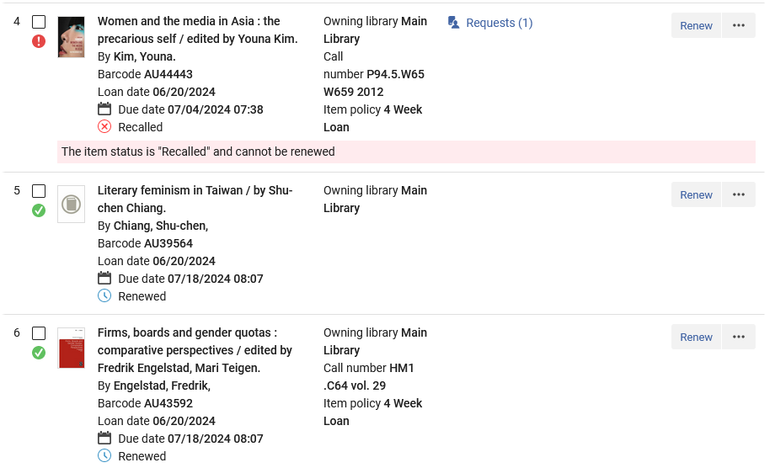
Bulk Actions
The staff user can also see the results of the activity in the list of loans

Slide 64
Labels and Links

Slide 65
Labels and Links
The list of loans includes Labels and Links highlighting important information about the listed loans.
This includes, for example,
  If the item is overdue
  If the item has a fine
  If the item has been recalled
  If the item has been renewed
  If the item has a loan note
  If the loaned item has been declared lost

Slide 66
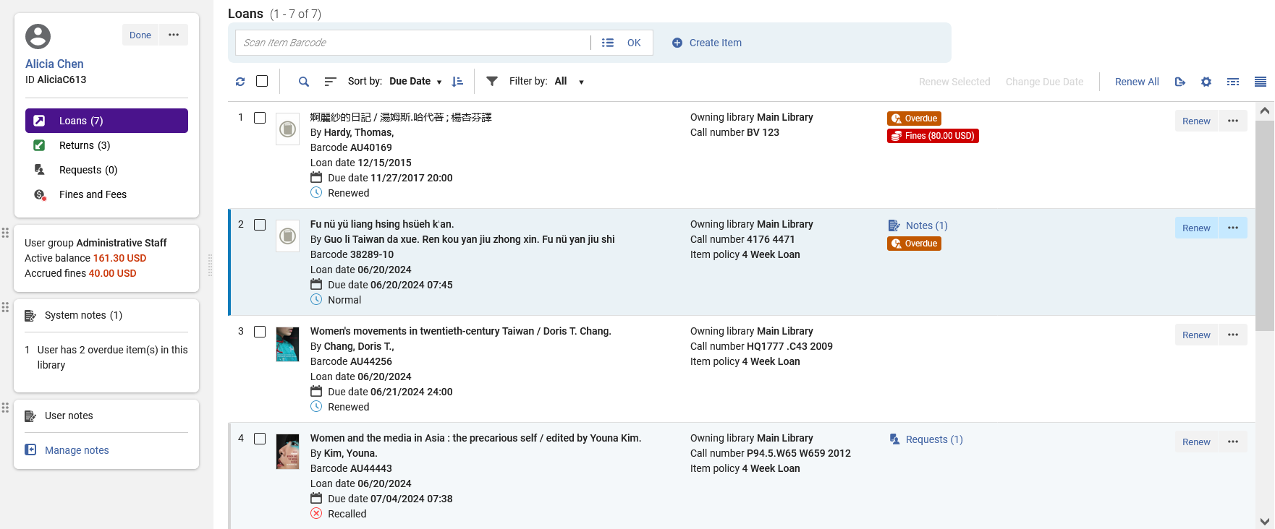
Labels and Links
This loan is both overdue and has a fine
This loan has been renewed
This loan is both overdue and has a note (we can click the notes link to view it)
This loan has not been renewed or recalled
This loan has a request (we can click the requests link to view it)
This loan has been recalled

Slide 67
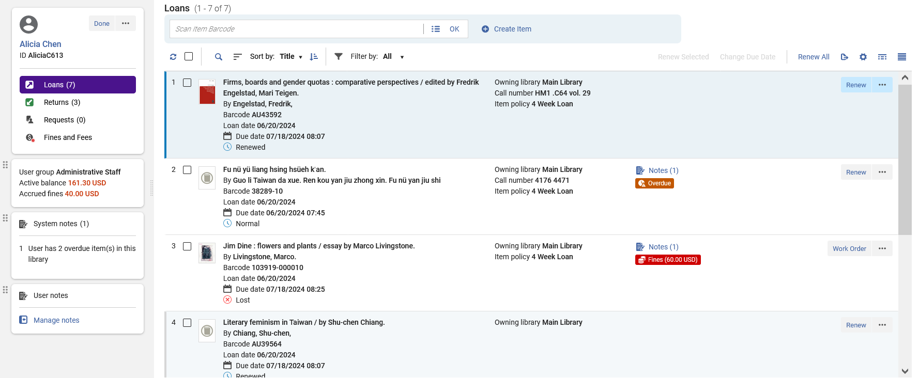
Labels and Links
This loan has
Been declared Lost
Has a Note
Has a fine

Slide 68
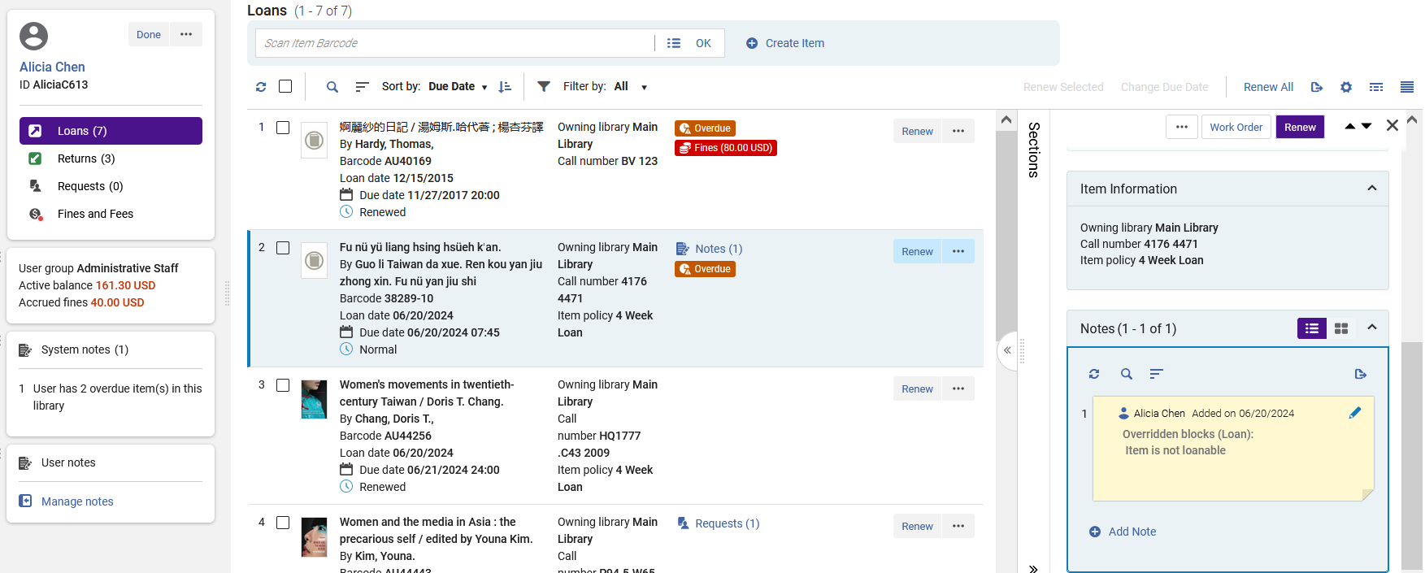
Labels and Links
After clicking the “Notes” link the record opens in split view focused on the notes

Slide 69
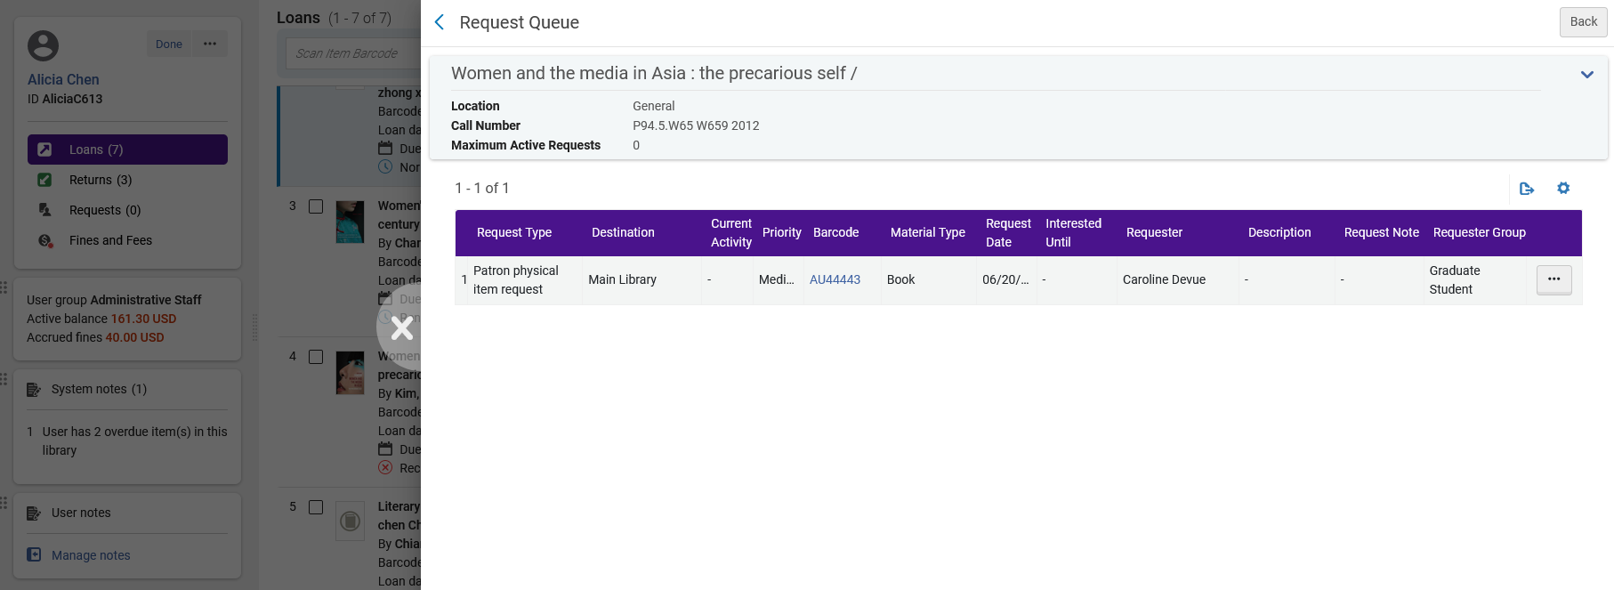
Labels and Links
After clicking the “Requests” link the Request Queue opens in a sliding panel

Slide 70
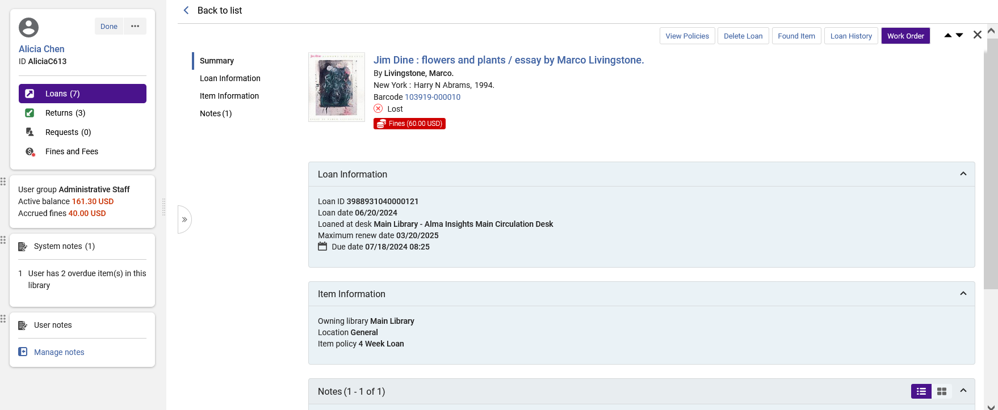
Labels and Links
Note that the labels and links also appear in the right pane view and the full view.
Here is the full view.

Slide 71
Table View and Record View

Slide 72
Table View and Record View
Until now we have been looking at the loans in “Record View”
It is also possible to view in “Table View”.
The “Table View” displays the same data as the “Record View” but (as the name suggests) in the form of a table.
The advantage of the “Table View” is that the data appears more “compact” thus showing more entities on the screen than the “Record View”.
The Record View and Table View is “sticky”, meaning that if a staff user chooses a specific view in a session, then when he or she exists and later returns to manage Patron Services the same view will appear.

Slide 73
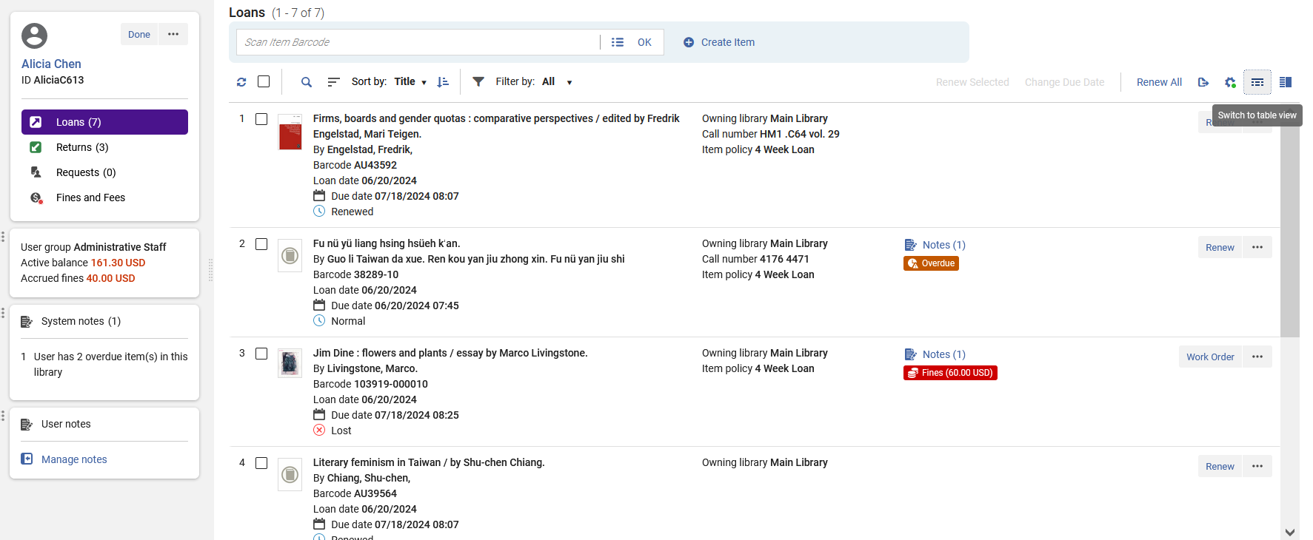
Table View and Record View
Toggle between Record View and Table View
From the Record View we will switch to Table View.
Note that not in Record View we see 4 loans.

Slide 74
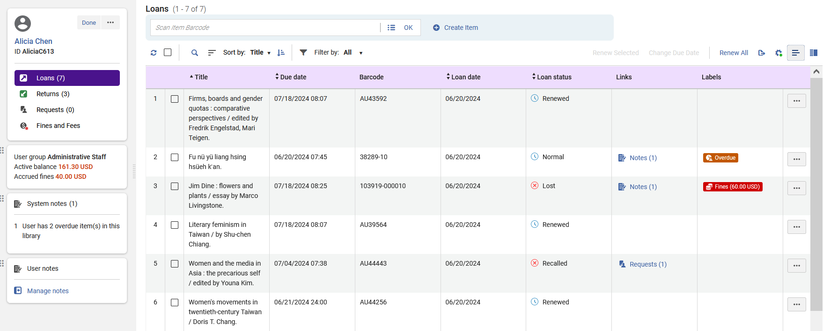
Table View and Record View
This is the Table View.
Note that now we see 6 loans (and in the record View we saw 4 loans).

Slide 75
Table View and Record View
Each user can customize the order of the columns.
For example, we will now move the Loan Date column to be before the Due Date column.
This is done by selecting and dragging using the mouse (as is also done in other places in Alma)

Slide 76
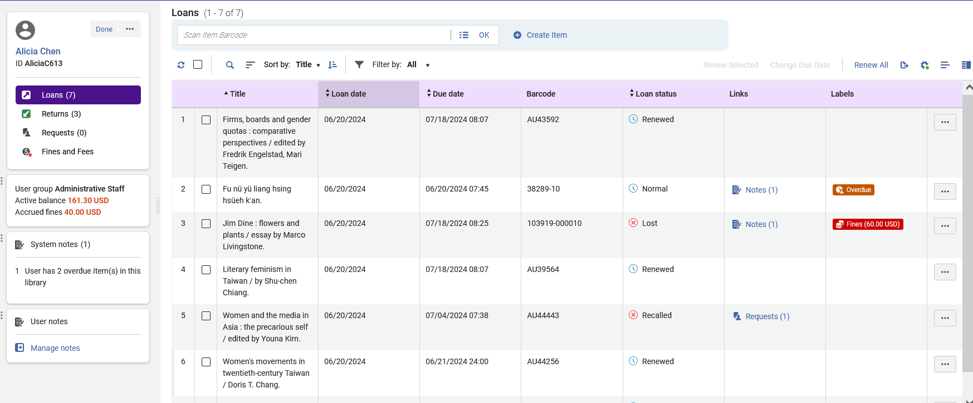
Table View and Record View
Now the column Loan Date is before the column Due Date.

Slide 77

Table View and Record View
Double clicking a row will open the record in Full View
We will now double click the first row for record “Firms, boards and gender quotas: comparative perspectives”.

Slide 78

Table View and Record View
The record has opened in Full View

Slide 79

Table View and Record View
The Table View includes the same Bulk Actions as the Record View.

Slide 80

Table View and Record View
The same actions which can be performed on each specific loan in the record View can also be preformed in the Table View.

Slide 81
Table View and Record View
We will now return to Record View

Slide 82

Table View and Record View
Now we have returned to the Record View

Slide 83

Table View and Record View
The Table View can also be viewed in Split Screen.

Slide 84

Table View and Record View
Here is the Table View in Split Screen.

Slide 85
Patron Services Page Timeout

Slide 86
Patron Services Page Timeout
The Patron Services Page Timeout is not new to the “New Manage Patron Services Page”.
It has existed for several years.
However, due to the fact that it also relates to the “New Manage Patron Services Page”. We will point it out here.

Slide 87
Patron Services Page Timeout
The Patron Services page is set by default to time out after two minutes of inactivity.
Because private patron information appears on the screen, it is a good idea to have it timeout after inactivity.
In this way the private patron information data will not remain on the screen if a staff user, for example, gets up from his or her desk and leaves the computer display on.
Each institution can configure the Patron Services page time out to be between 1 and 30 minutes by modifying the patron_services_timeout_minutes parameter.
This is accessed at “Configuration > Fulfillment > General > Other Settings”.

Slide 88

Patron Services Page Timeout
The Patron Services page is set to timeout after three minutes

Slide 89

Patron Services Page Timeout
The Patron Services Page is open.
We will wait three minutes and not perform any activity and see what happens

Slide 90

Patron Services Page Timeout
After three minutes of no activity, we are automatically redirected to the Patron Identification screen.
There is now no personal data appearing on the screen.

